Slide 1

CRM
Practical
Deployment Services

Slide 2
Agenda
08:00-09h00: Registration - Morning coffee and Finger food - Gimasys team
09h00-09h10: Welcome Note & Agenda Overview - Ms.Adelyn & Mr.Dinh Kien Quoc
09h10-10h00: Keynote - The Asia Customer Experience Imperative – Omni Channel engagement helping companies grow Revenue: Why & How * With a quick 10 minutes Demo -Mr. Punnet Sharma
10:00 - 10:15: Why Go with Salesforce and What is The Next Journey - Techcombank Securities
10h15-10h45: Turning CRM Ideas into Reality for your Business - How Gimasys can Help - Practical Deployment Service & Integration Demo - Mr.Dinh Kien Quoc
10:45 - 10:55: Tea-break
10:55 - 11:30: Customer Success Stories - Be8 - Sean
11:30 - 11:45: Q&A - All Presenters
11:45: Close + Wrap Up - Mr. Dinh Kien Quoc & Ms.Adelyn

Slide 3
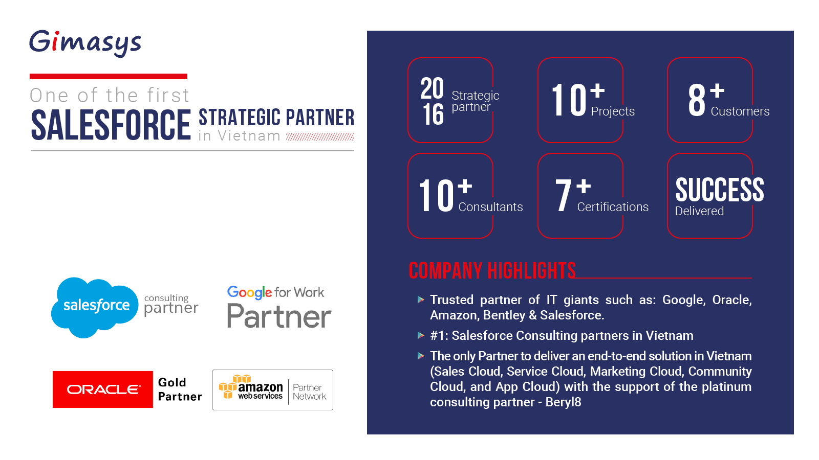

Slide 4
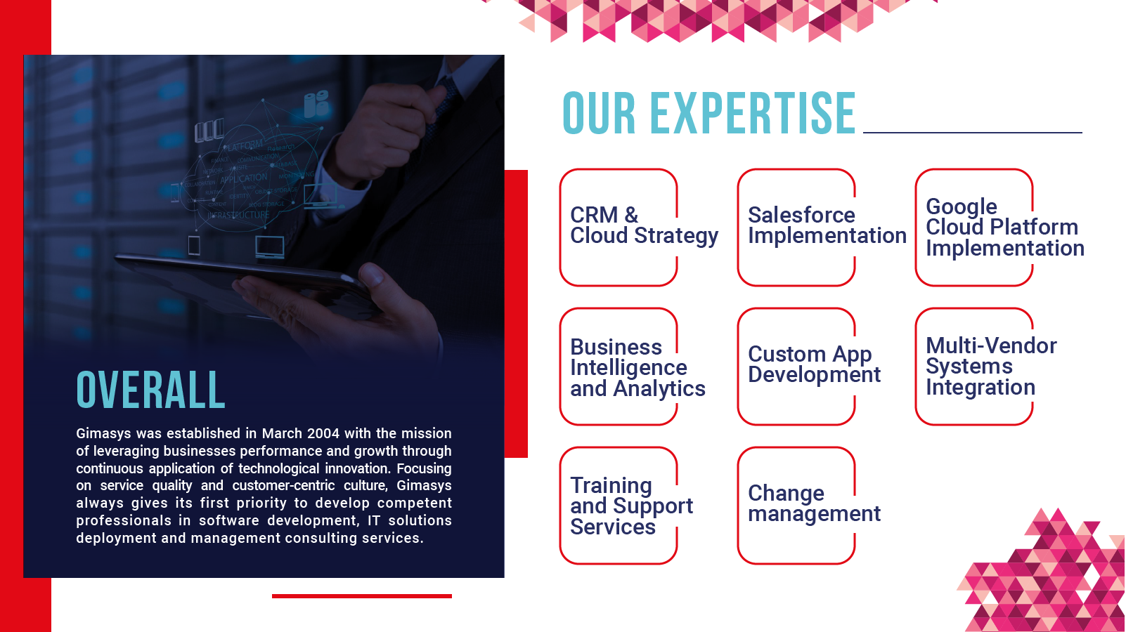

Slide 5


Customer experience in Vietnam
Vấn đề về quy trình hỗ trợ khách hàng
Xin lỗi quý khách, hiện tại các đường dây đểu bận, xin quý khách vui lòng gọi lại sau !
Vấn đề quá tải hệ thống call center theo thời điểm
Vấn đề truyền thông nội bộ và liên lạc với khách hàng

Slide 6


What is in the World
Lightning Service Console with Omni chanenel
Service Cloud LiveMessage

Slide 7
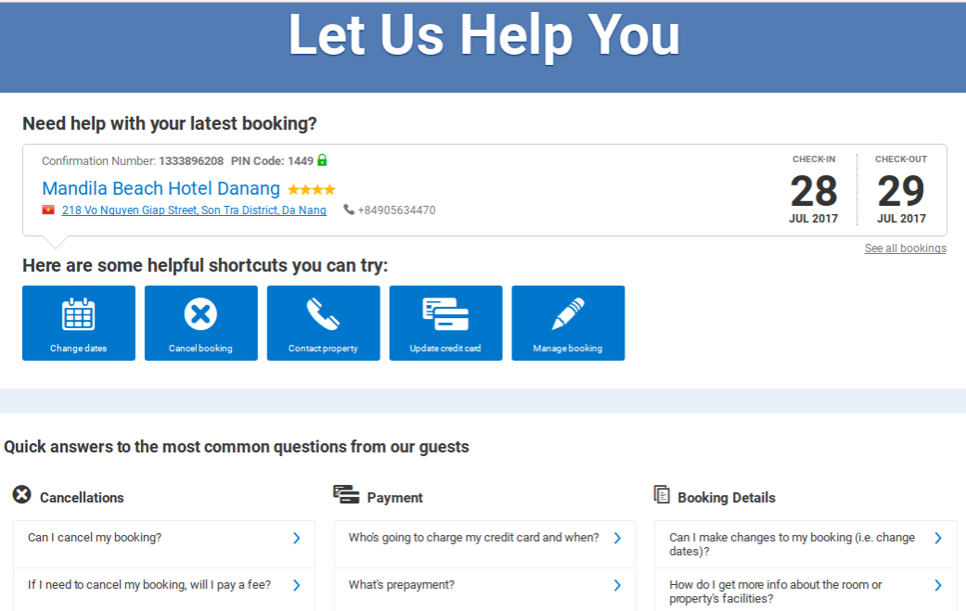
What is in the World
Self Services Portal

Slide 8
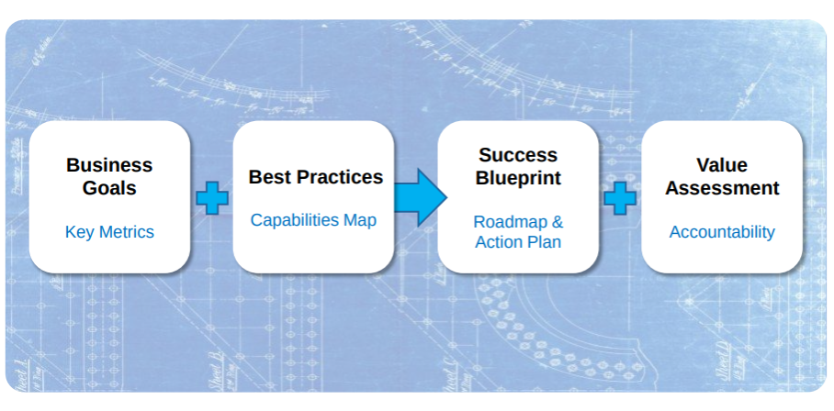
What is success Salesforce implementation

Slide 9
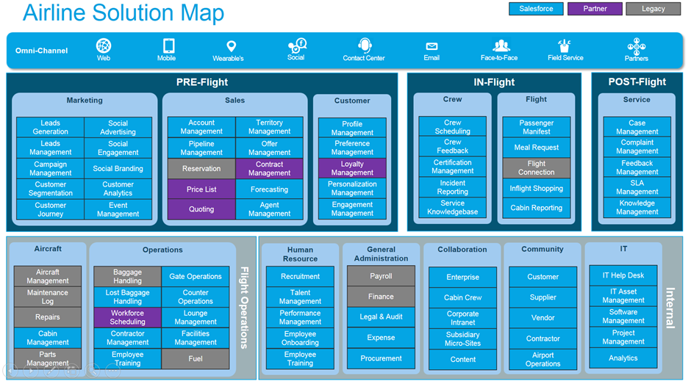

Slide 10
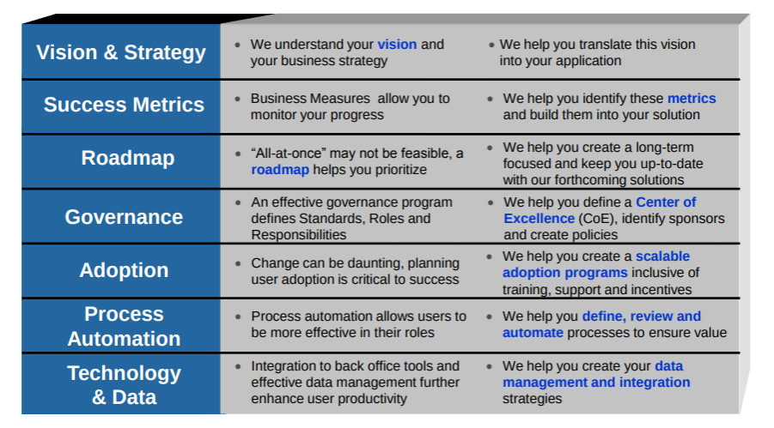
Success Blueprint : Putting it all together

Slide 11
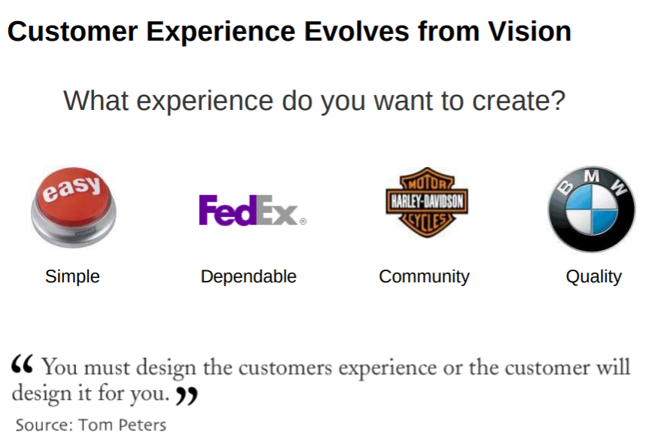
Vision & Strategy

Slide 12
How to build a Salesforce Roadmap
The Roadmap should include:
Business Summary
Key business challenges
Key performance indicators
Measureable goals
2. Thorough discovery
Current vs. desired state
Overview of all systems in the business
Process mapping
3. High-level system requirements
Nice to haves vs. must haves
Included vs. excluded
Plans for innovation
How will you support continued releases and new products?
How will you continue to implement deeper into the Salesforce platform?
Timelines
Desired state for 1, 3 and 5 years from now
Strategy for who will support the Roadmap
Internal vs. external resources

Slide 13












What do you need to Aim For
“We need to transform!”
“Need to be more efficient!”
“Just give us the basics!”
Service Journeys
Connected Products
Intelligent Routing
Intelligent Self-Service Communities
Messaging
Agent Single View & Tools
Automated responses/Service Bots
Embed Support In App
Knowledge
Cross-sell & Upsell
Self-Service
Field Service
Service Analytics
Social Customer Service
Phone, Email, Web
Notes:
So I had an experience with a company that provides great service, that could have been even slightly better, but bot everyone is even at that point yet.
So first up, before we delve too deep, I want to ask you a question. Be honest in your own appraisal – where do you think your organisation is at today? The good and bad news is, that no matter where you believe you are at – you are NOT done ☺ The transformation journey doesn’t stop.
And maybe you have some of the basics and some advanced capabilities today as well, based on your organisations own unique needs – that’s great as well.
While we are focussing in today on 3 key themes, underlying these, there are a range of capabilities that will help you transform.
I speak to a LOT of organisations today that are looking at advanced capabilities such as Connected Products and even Service Bots, but are yet to the foundational basics right, such as a great agent single view, self service and the ability to respond across fundamental channels such as phone, and email.
So keep this in mind as well – this is not a big bang approach to transform the customer experience!

Slide 14
What are challenges for CRM Implementation
The 8 most common issues when implementing CRM:
How you can address each of these challenges—and how we can help
Lack of strategic vision
No project team
No clear business process
Not knowing how to measure success
No change management process
Inadequate training
Dirty data
Not getting help
Challenge #1: Define strategic vision
Challenge #2: Build up a project team
Challenge #3: Define business process
Challenge #4: Define success
Challenge #5: Manage change
Challenge #6: Train and train again
Challenge #7: Clean your data and keep it clean
Challenge #8: Know where to get help

Slide 15
05 steps to a successful implementation
1. Plan and prepare
2. Set up and customize
3. Deploy Salesforce CRM
4. Drive adoption
5. Continuously improve

Slide 16
1. Plan and prepare overview
1. Organize your team
2. Set realistic goals
3. Process mapping
4.Understand your data
5. Choose an implementation approach
6. Build a project timeline

Slide 17
1.Plan and prepare - Organize your team
All project teams should include the following participants:
An executive sponsor
One or more system administrators
A project manager
One or more power users
One or more trainers
Notes:
Organize your team The size and scope of your rollout will determine how many resources you need. However, all project teams should include the following participants:
An executive sponsor – The project’s executive champion should participate and support the initiative from the beginning, through go-live and beyond.
One or more system administrators – This person should be involved throughout the implementation and afterward. It’s important that the administrator understand the business processes and requirements from managers and users. For information about how to plan administrator resources, see the Best Practice document “Achieving outstanding CRM administration.”
A project manager – This person leads the implementation and makes sure the project tasks and overall timeline are on track.
One or more power users – These users help make sure your project will meet the needs of the end users, including management. We also recommend that you use power users as first-line support. To fill that role, consider training these users first and then providing more in-depth training.
One or more trainers – Trainers need to identify relevant materials from salesforce.com or develop custom training materials (such as quick-reference guides). You’ll need materials both for the initial implementation to on-board new users and once the application is live, for remediation or for new functionality

Slide 18
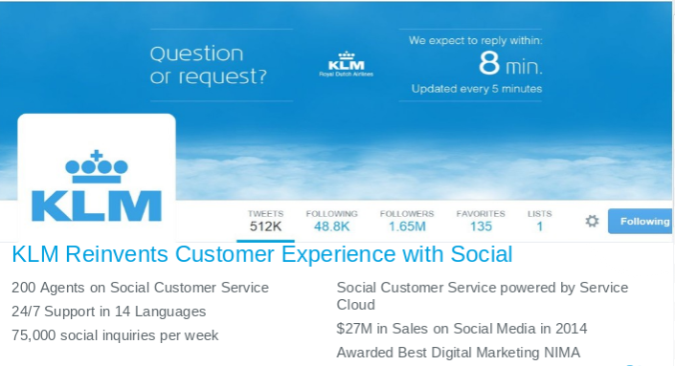
1.Plan and prepare - Set realistic goals
“Build and maintain long-term relationships with valuable customers by creating personalized experiences across all touch-points and by anticipating customer needs and providing customized offers.”
“Customer loyalty is our highest priority.”
“Provide the highest level of personalized service for all customers and give customers the communication channels they want”
Notes:
Organize your team The size and scope of your rollout will determine how many resources you need. However, all project teams should include the following participants:
An executive sponsor – The project’s executive champion should participate and support the initiative from the beginning, through go-live and beyond.
One or more system administrators – This person should be involved throughout the implementation and afterward. It’s important that the administrator understand the business processes and requirements from managers and users. For information about how to plan administrator resources, see the Best Practice document “Achieving outstanding CRM administration.”
A project manager – This person leads the implementation and makes sure the project tasks and overall timeline are on track.
One or more power users – These users help make sure your project will meet the needs of the end users, including management. We also recommend that you use power users as first-line support. To fill that role, consider training these users first and then providing more in-depth training.
One or more trainers – Trainers need to identify relevant materials from salesforce.com or develop custom training materials (such as quick-reference guides). You’ll need materials both for the initial implementation to on-board new users and once the application is live, for remediation or for new functionality

Slide 19
1.Plan and prepare - Process Mapping
Standard Service Cloud Process
1. Log a Case
2. Case resolution process
3. Self Service Portal

Slide 20
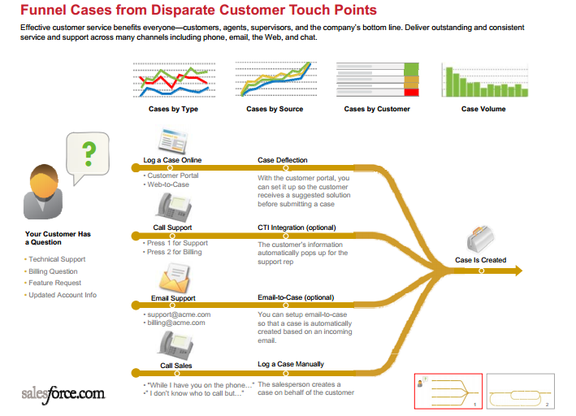

Slide 21
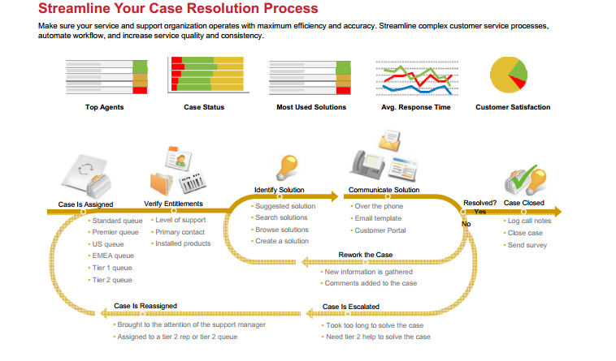

Slide 22
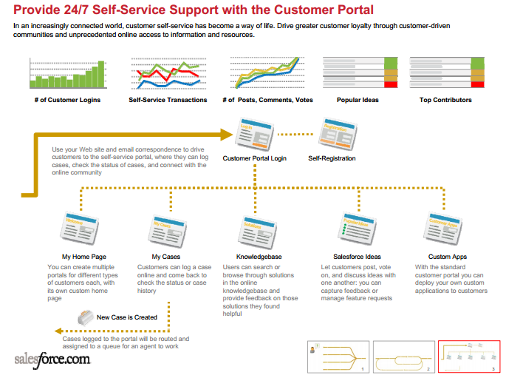

Slide 23
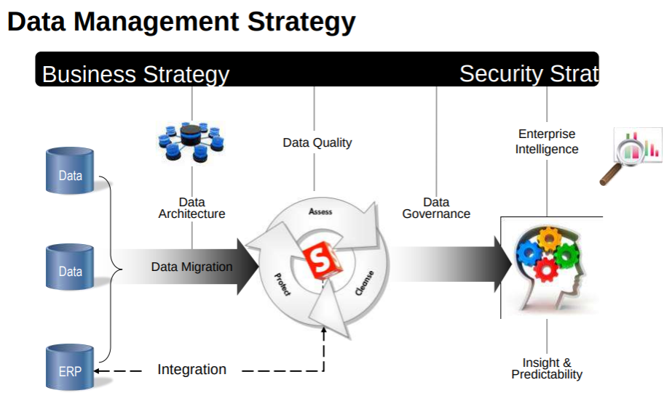
1.Plan and prepare - Understand your data
Define the Fields Needed for Your Process
Define Needed Reports
Define Integration scope
Prepare to Import Data
Notes:
Organize your team The size and scope of your rollout will determine how many resources you need. However, all project teams should include the following participants:
An executive sponsor – The project’s executive champion should participate and support the initiative from the beginning, through go-live and beyond.
One or more system administrators – This person should be involved throughout the implementation and afterward. It’s important that the administrator understand the business processes and requirements from managers and users. For information about how to plan administrator resources, see the Best Practice document “Achieving outstanding CRM administration.”
A project manager – This person leads the implementation and makes sure the project tasks and overall timeline are on track.
One or more power users – These users help make sure your project will meet the needs of the end users, including management. We also recommend that you use power users as first-line support. To fill that role, consider training these users first and then providing more in-depth training.
One or more trainers – Trainers need to identify relevant materials from salesforce.com or develop custom training materials (such as quick-reference guides). You’ll need materials both for the initial implementation to on-board new users and once the application is live, for remediation or for new functionality

Slide 24
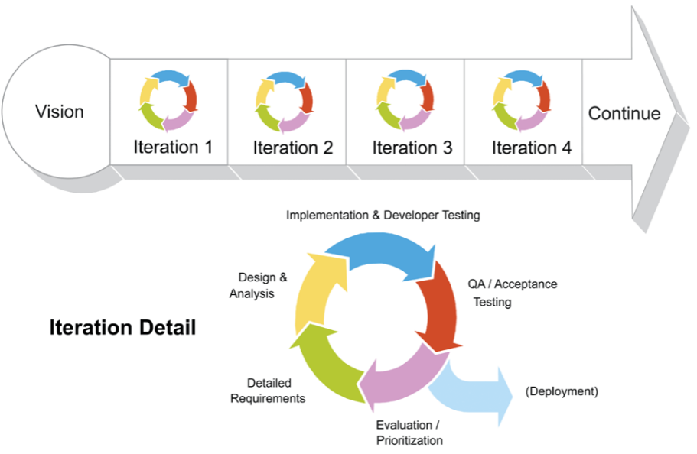
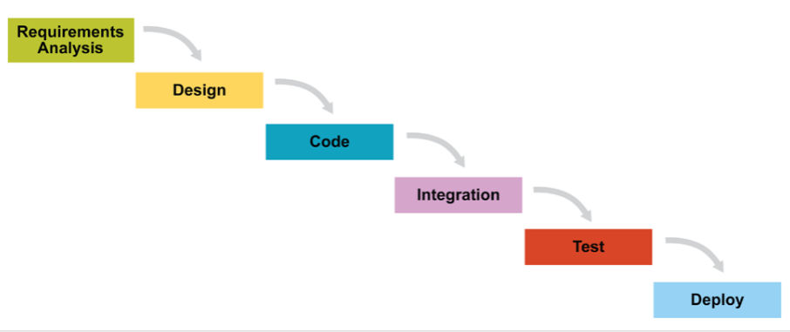
1.Plan and prepare - Choose an implementation approach
Scrum - iterative approach
Waterfall - sequential approach
Notes:
Organize your team The size and scope of your rollout will determine how many resources you need. However, all project teams should include the following participants:
An executive sponsor – The project’s executive champion should participate and support the initiative from the beginning, through go-live and beyond.
One or more system administrators – This person should be involved throughout the implementation and afterward. It’s important that the administrator understand the business processes and requirements from managers and users. For information about how to plan administrator resources, see the Best Practice document “Achieving outstanding CRM administration.”
A project manager – This person leads the implementation and makes sure the project tasks and overall timeline are on track.
One or more power users – These users help make sure your project will meet the needs of the end users, including management. We also recommend that you use power users as first-line support. To fill that role, consider training these users first and then providing more in-depth training.
One or more trainers – Trainers need to identify relevant materials from salesforce.com or develop custom training materials (such as quick-reference guides). You’ll need materials both for the initial implementation to on-board new users and once the application is live, for remediation or for new functionality

Slide 25
1.Plan and prepare - Build a project timeline
Chose an implementation approach and prioritized all requirements to build the project timeline.
Every timeline needs to include the time required to design, build, and deploy.
Prioritization of requirements is also key to ensure any “must-haves” are included in the first phase or rollout.
Notes:
Organize your team The size and scope of your rollout will determine how many resources you need. However, all project teams should include the following participants:
An executive sponsor – The project’s executive champion should participate and support the initiative from the beginning, through go-live and beyond.
One or more system administrators – This person should be involved throughout the implementation and afterward. It’s important that the administrator understand the business processes and requirements from managers and users. For information about how to plan administrator resources, see the Best Practice document “Achieving outstanding CRM administration.”
A project manager – This person leads the implementation and makes sure the project tasks and overall timeline are on track.
One or more power users – These users help make sure your project will meet the needs of the end users, including management. We also recommend that you use power users as first-line support. To fill that role, consider training these users first and then providing more in-depth training.
One or more trainers – Trainers need to identify relevant materials from salesforce.com or develop custom training materials (such as quick-reference guides). You’ll need materials both for the initial implementation to on-board new users and once the application is live, for remediation or for new functionality

Slide 26
2.Set up and customize
1. Define the security settings
2. Config the system
3. Customize the application
4. Make integration with other system
5. Create reports
6. Testing

Slide 27
3.Deploy Salesforce CRM
1. Add users
2. Import data
3. Train Admin
4. Train end users
5. Rollout
6. Support

Slide 28
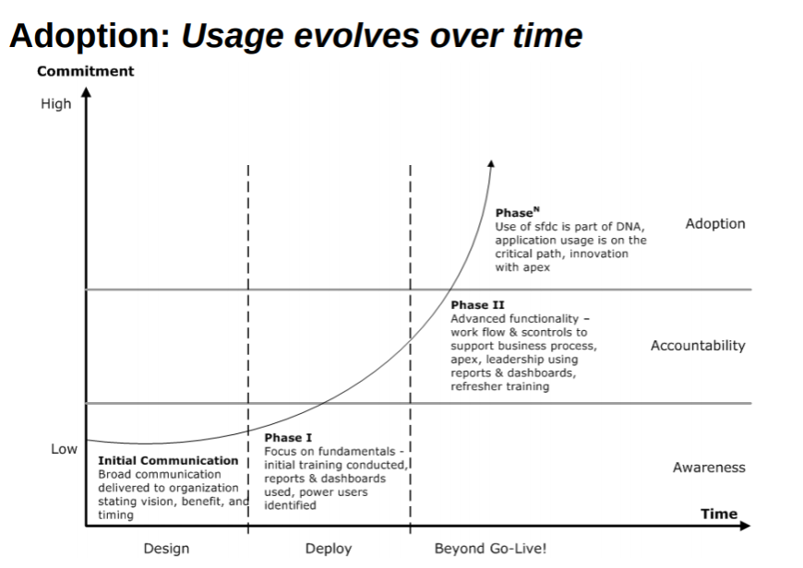
4.Drive adoption

Slide 29
4.Drive adoption
Identify and reward the strongest adopters - gave away iPhone to the strongest adopters.
Communicate about new product features that will help users in their daily work.
Take the approach, “If it isn’t in Salesforce CRM, it doesn’t exist.”
Tie adoption to compensation.
Mandate both timeliness and data quality.
Provide productivity tools such as templates and dashboards

Slide 30
5.Continuously improve
Collect user feedback
Respond to user feedback
Measure adoption trends
Encourage user adoption with incentives
Add functionality to boost productivity and adoption
Define a strategy for maintaining data quality
Join the Salesforce.com Community
Define a strategy for managing releases

Slide 31
Salesforce Integration
SSO
Data integration
Call Center integration

Slide 32
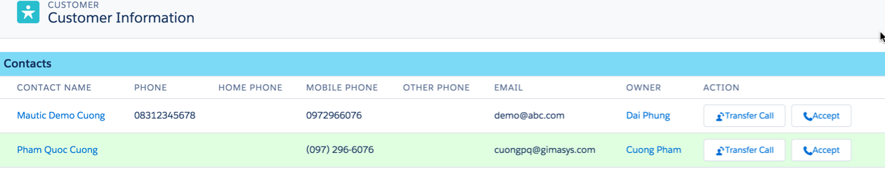
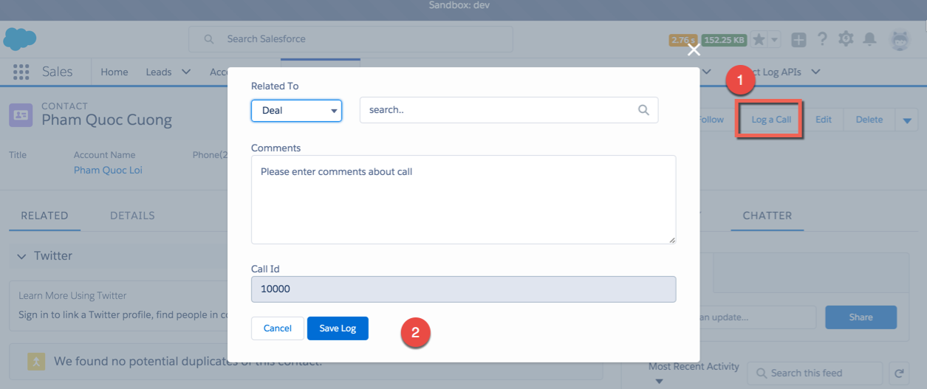
Salesforce Call Center Integration

Slide 33
Salesforce Data Integration
User
Interface
Tích hợp mức giao diện : Hiển thị màn hình của hệ thống khác trên giao diện người dùng Salesforce
Application
Logic
Tích hợp mức xử lý nghiệp vụ: Truy xuất dữ liệu từ hệ thống khác để tham gia vào xử lý quy trình nghiệp vụ
Data
Layer
Tích hợp mức dữ liệu : Chuyển các dữ liệu cần thiết lên môi trường salesforce

Slide 34
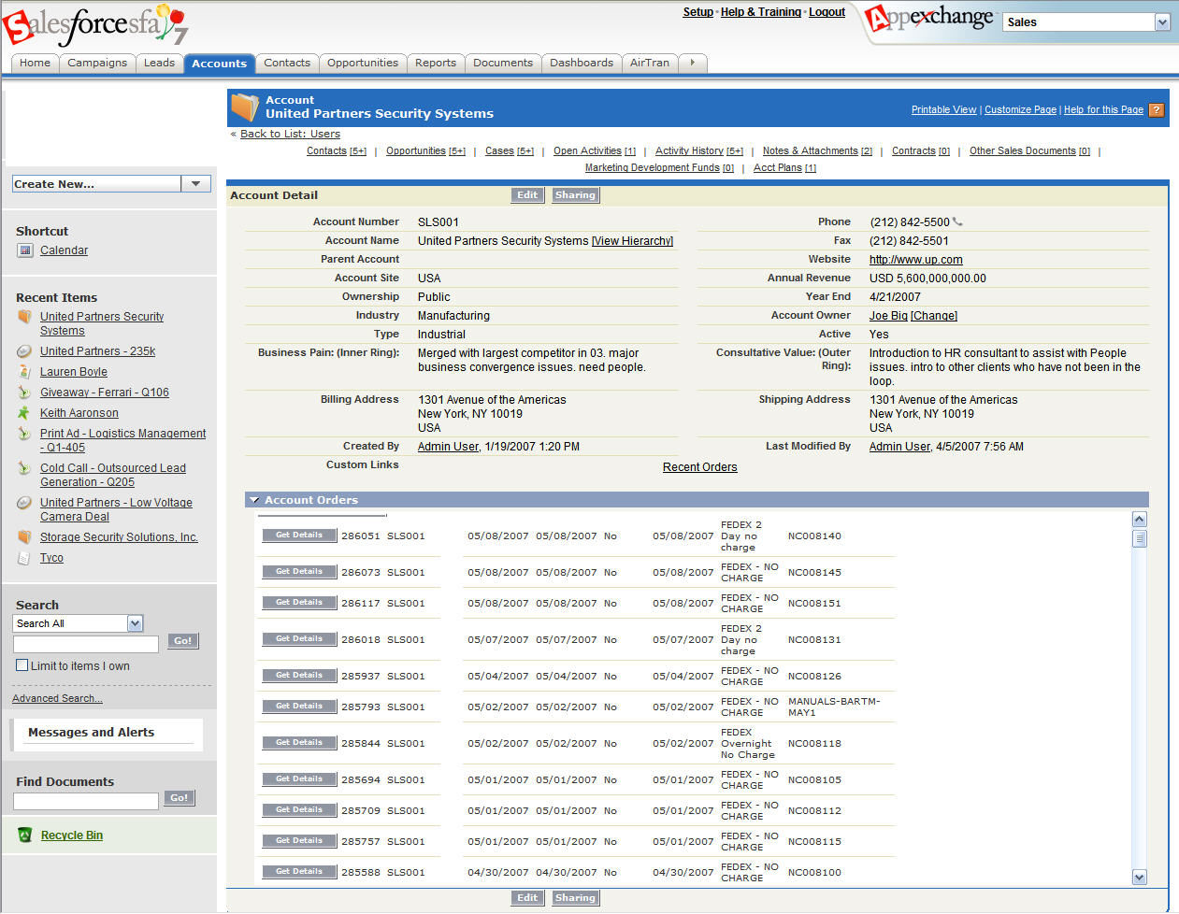

Mô hình 1 : Tích hợp mức giao diện (User Interface)
Tích hợp màn hình giao diện của hệ thống khác vào màn hình Salesforce

Slide 35
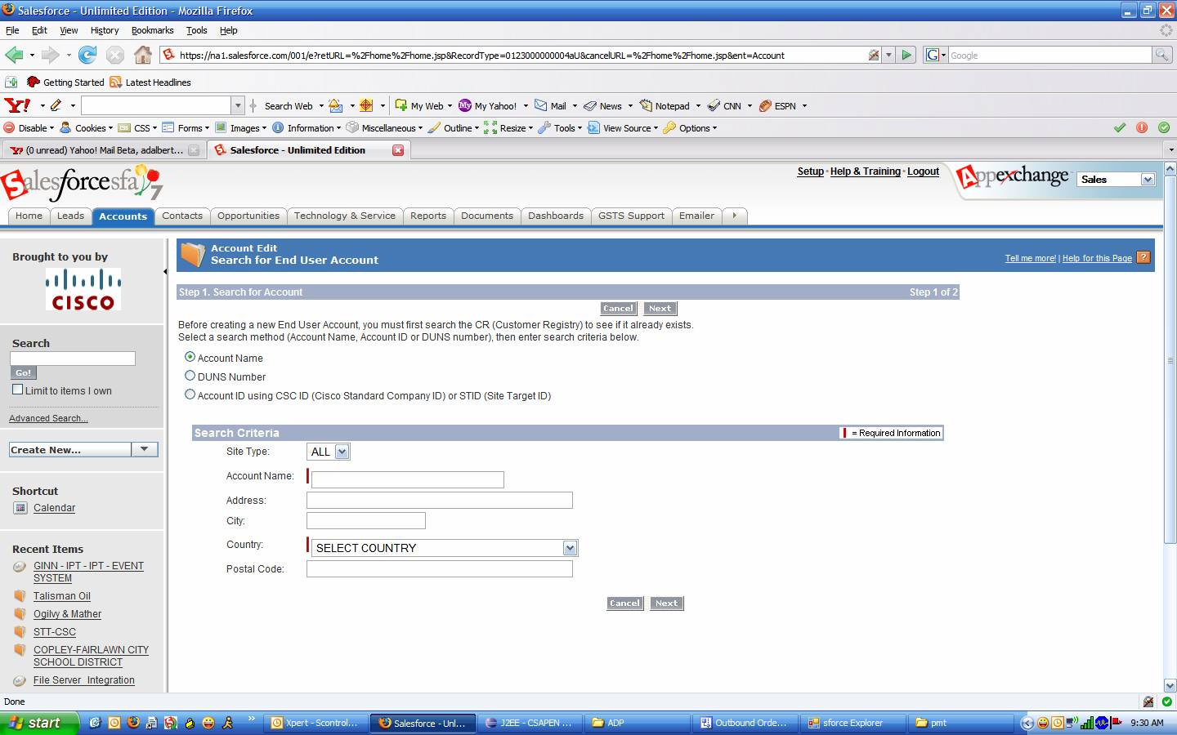

Mô hình 2: Tích hợp mức xử lý nghiệp vụ (Application Logic)
Hệ thống Salesforce tại Cisco gọi đến hệ thống khác để kiểm tra thông tin khách hàng
Real-time Call Out

Slide 36
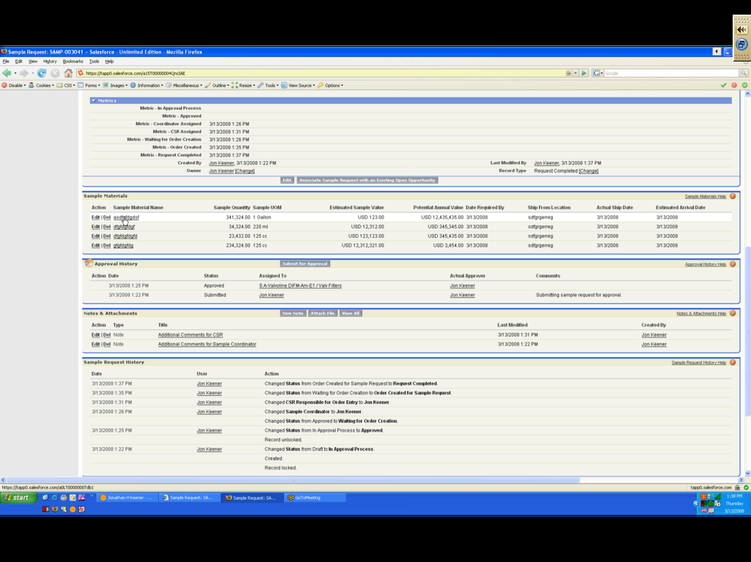


Mô hình 3: Tích hợp mức dữ liệu (Data Layer)
Vùng thông tin của Salesforce
Đưa thông tin về hoá đơn từ SAP lên lưu trữ và hiển thị trên Salesforce
Hiển thị Hoá đơn của SAP ERP

Slide 37
Salesforce Data Integration Demo
ERP integration - Real time data query

Slide 38
Notes:
Thank you!

